Slide 1
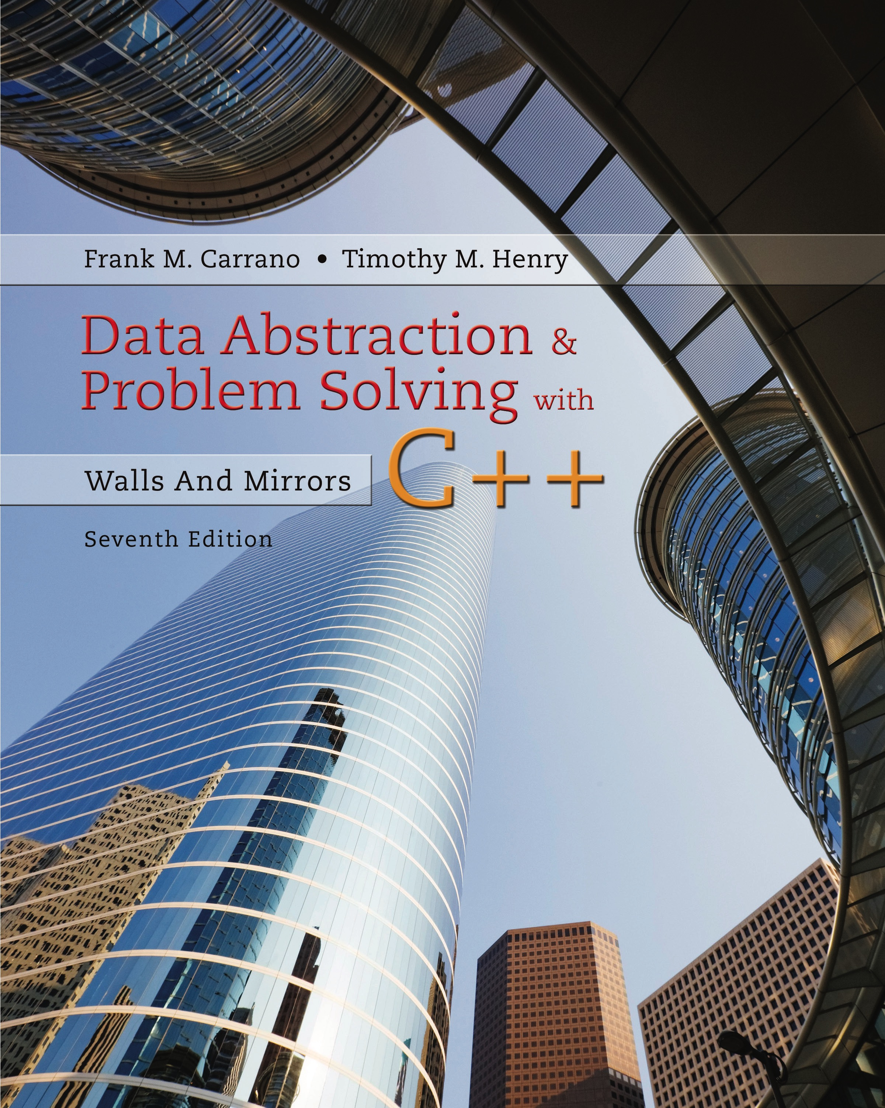
Data Abstraction & Problem Solving with C++: Walls and Mirrors
Seventh Edition
C++ Interlude 7
Data Abstraction: The Walls
Copyright © 2017, 2013, 2007 Pearson Education, Inc. All Rights Reserved
Notes:
If this PowerPoint presentation contains mathematical equations, you may need to check that your computer has the following installed:
1) MathType Plugin
2) Math Player (free versions available)
3) NVDA Reader (free versions available)

Slide 2

Iterators (1 of 2)
Iterator
An object that traverses a collection of like objects
Each item is considered once
Example: a loop to display a list

Slide 3
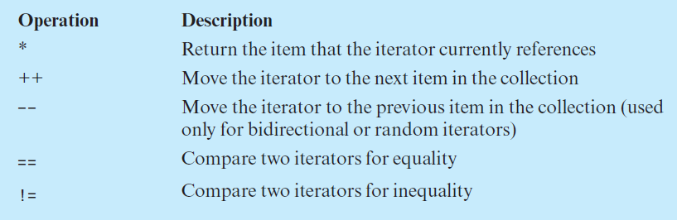
Iterators (2 of 2)
Common iterator operations

Slide 4

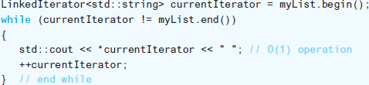
Using Iterator Operations (1 of 2)
Given class of iterators and specified methods
Now use to traverse entries in myList

Slide 5
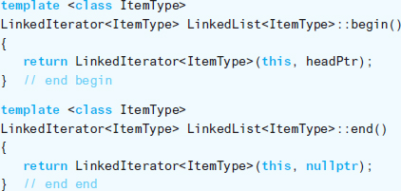
Using Iterator Operations (2 of 2)
Method declarations

Slide 6
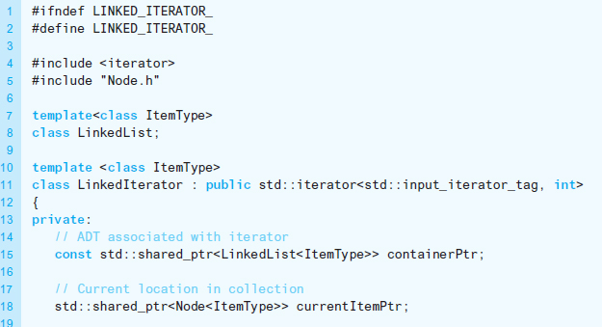
Implementing an Iterator (1 of 5)
Listing C7-1 The header file for the class LinkedIterator

Slide 7
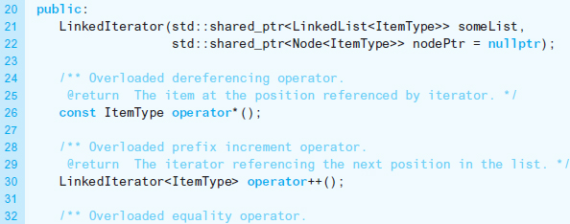
Implementing an Iterator (2 of 5)
Listing C7-1 [Continued]

Slide 8
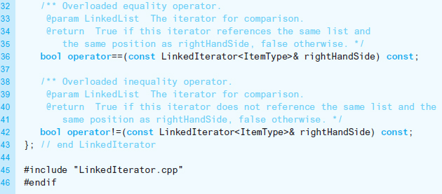
Implementing an Iterator (3 of 5)
Listing C7-1 [Continued]

Slide 9
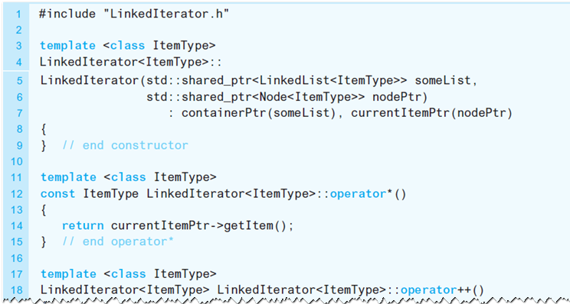
Implementing an Iterator (4 of 5)
Listing C7-2 The implementation file for the class LinkedIterator

Slide 10
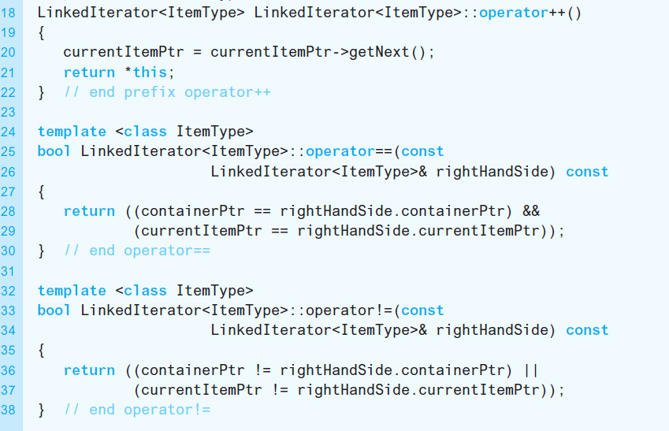
Implementing an Iterator (5 of 5)
Listing C7-2 [Continued]

Slide 11

Advanced Iterator Functionality (1 of 2)
Using iterators C + + functions

Slide 12

Advanced Iterator Functionality (2 of 2)
Using iterators C + + functions

Slide 13

Copyright

